Slide 1
Encoding Text
Notes:
Up until this point in the course, we’ve been moving up to bigger and bigger code structures.
From ints and floats, to lists and strings, to modules and classes…
Today, we’re heading in the other direction.
We want to know how a computer can store all the types of data we use when, at some level, it’s all binary—just zeros and ones.
When we’re just working in Python, we usually don’t have to worry about this level of representation.

Slide 2
Text Encoding
Convert text to binary
Need to map each character to a binary sequence
Binary sequences are a number in base 2
Some examples
0000 is 0
0001 is 1
0010 is 2
Notes:
As a data scientist, you’ll collect data from other sources:
Websites
Publicly advertised servers
Files created by other people
We can classify these sources as text data or binary data
How can we get a computer to process text characters?
We know that at some level, text has to be binary, so we need to map each character to a binary sequence.

Slide 3
Text: ASCII
The first major system for encoding text was called ASCII.
American Standard Code for Information Interchange (ASCII)
First published in 1963
Every ASCII character takes 7 bits.
This means that you can only get 2⁷ = 128 characters
Notes:
Note about ASCII still taking memory of 8 bits (one byte)
Of course, ASCII was far too limiting.
It doesn’t even cover all the characters we use to write English, let alone other major languages.
There have been a lot of attempts to create larger character encodings.
Windows code, Latin-1, etc.
These are unfortunately often incompatible and cause errors if you don’t know exactly how to process the bits you’re getting.

Slide 4
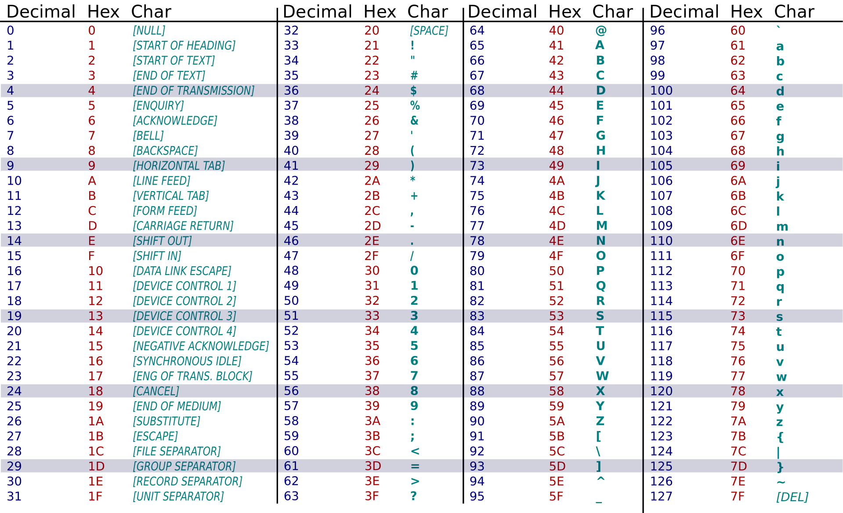
ASCII Table

Slide 5
Unicode
Defines a set of more than 120,000 different characters
Modern languages, ancient languages, mathematical symbols
Unicode is an abstraction, assigning an order to characters
The character encodings that take each Unicode character and map it to a sequence of bytes
The most popular one is UTF-8

Slide 6
UTF-8
The “8” stands for eight bits, or one byte.
Every character in UTF-8 gets 1–4 bytes.
The original ASCII characters are encoded with one byte using their original ASCII encoding.
So UTF-8 is very compact for these characters.
UTF-8 is the most popular standard.
In June 2021, 96.9% of all web pages used UTF-8.
Notes:
UTF-8 is becoming a popular standard.
96.9% of all web pages in June 2021
This is what you want to use if you have a choice.
But there are times when you have to interact with other encodings in Python.
We’ll explore how to encode and decode text in the next segments.

Slide 7
Encoding Text

